Slide 1
Heteroskedasticity
Part 1
BUAN / MECO 6312
Dr. Moran Blueshtein
University of Texas - Dallas

Slide 2
The Nature of Heteroskedasticity
Consider our basic model:
We assumed:
if all observations come from probability density functions with the same variance, then e and therefore also y are homoskedastic.

Slide 3
The Nature of Heteroskedasticity
When the variances for all observations are not the same, we have heteroskedasticity
Heteroskedasticity is often encountered when using cross-sectional data
The term cross-sectional data refers to having data on a number of economic units such as firms or households, at a given point in time.
Cross-sectional data invariably involve observations on economic units of varying sizes.

Slide 4
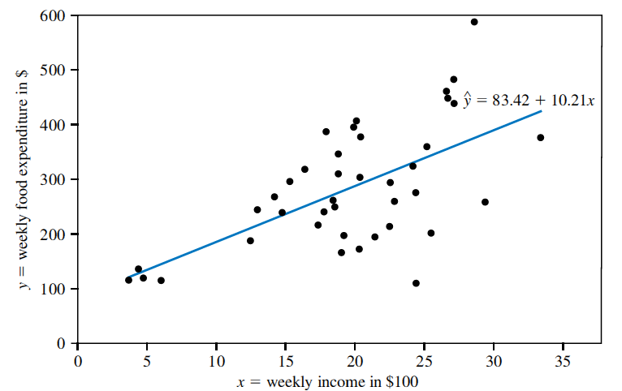
The Nature of Heteroskedasticity
Least squares estimated food expenditure function and observed data points
As the size of the economic unit becomes larger, there is more uncertainty associated with the outcomes y.

Slide 5
The Nature of Heteroskedasticity
The variance of the error term is greater as X is bigger
This greater uncertainty is modeled by specifying an error variance that is larger, the larger the size of the economic unit.
where h(x_{i}) is a function of x_{i} that increases as x_{i} increases.

Slide 6
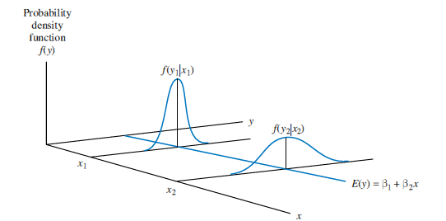
The Nature of Heteroskedasticity
Heteroskedastic errors

Slide 7
The Nature of Heteroskedasticity
Consequences for the Least Squares Estimators
There are two implications of (ignoring) heteroscedasticity:
The least squares estimator is still a linear, unbiased and consistent estimator, but it is no longer best
There is another estimator with a smaller variance
The standard errors that are computed for the least squares estimator are incorrect
Confidence intervals and hypothesis tests that use these standard errors will be misleading

Slide 8
The Nature of Heteroskedasticity
Consequences for the Least Squares Estimators
What happens to the standard errors?
Consider the model:
The variance of the least squares estimator for β₂ as:

Slide 9
Assessing the Least Squares Fit
Consequences for the Least Squares Estimators

Slide 10
The Nature of Heteroskedasticity
Consequences for the Least Squares Estimators
Now let the variances differ:
Consider the model:
The variance of the least squares estimator for β₂ is:

Slide 11
The Nature of Heteroskedasticity
Consequences for the Least Squares Estimators
If we proceed to use the least squares estimator the software will use a wrong formula (assuming homoskedasticity) and therefore the standard error of the estimator b₂ is incorrect.

Slide 12
Detecting Heteroskedasticity

Slide 13
Detecting Heteroskedasticity
There are two methods we can use to detect heteroskedasticity
An informal way using residual charts.
A formal way using statistical tests.

Slide 14
Detecting Heteroskedasticity
Residual Plots
If the errors are homoskedastic, there should be no patterns of any sort in the residuals.
If the errors are heteroskedastic, they may tend to exhibit greater variation in some systematic way
we can plot the least squares residuals against each suspicious explanatory variable, or against to see if they vary in a systematic way.

Slide 15
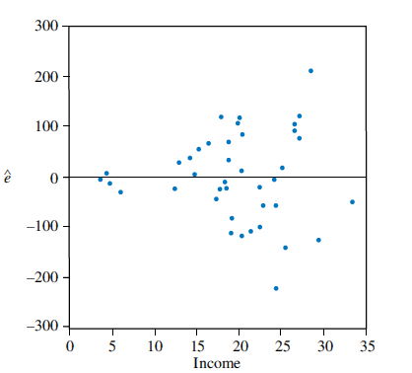
Detecting Heteroskedasticity
Least squares food expenditure residuals plotted against income
Residual Plots

Slide 16
Detecting Heteroskedasticity
White Test
Consider the general multiple regression model:
A general form for the variance function related is:
Where z’s are combinations and functions of x’s.

Slide 17
Detecting Heteroskedasticity
White Test
Notice that when
then:
But is a constant

Slide 18
Detecting Heteroskedasticity
White Test
So, when:
heteroskedasticity is not present
The null and alternative hypotheses are:

Slide 19
Detecting Heteroskedasticity
The White Test
Suppose our model is:
The White test without cross-product terms (interactions) specifies:
Including interactions adds one further variable

Slide 20
Detecting Heteroskedasticity
The White Test
The White test is performed as an F-test or using:

Slide 21
Detecting Heteroskedasticity
Testing the Food Expenditure Example
White test estimates:
Test H₀: α₂ = α₃ = 0 against H₁: α₂ ≠ 0 or α₃ ≠ 0
Calculate:
The 5% critical value is χ_{(0.95, 2)} = 5.99
We conclude that heteroskedasticity exists

Slide 22
Heteroskedasticity
Part 2
BUAN / MECO 6312
Dr. Moran Blueshtein
University of Texas - Dallas

Slide 23
Consequences for the Least Squares Estimators
Recall that there are two problems with using the least squares estimator in the presence of heteroskedasticity:
The least squares estimator, although still being unbiased and consistent, is no longer best
The usual least squares’ standard errors are incorrect, which invalidates confidence intervals and hypothesis tests

Slide 24
Heteroskedasticity-Robust Standard Errors

Slide 25
Heteroskedasticity-Consistent Standard Errors
There are two problems with using the least squares estimator in the presence of heteroskedasticity:
The least squares estimator, although still being unbiased and consistent, is no longer best
We can tolerate this. We will keep using the least squares estimator.
The usual least squares’ standard errors are incorrect, which invalidates confidence intervals and hypothesis tests.
There is a way of correcting the standard errors so that our confidence interval and hypothesis tests are valid.

Slide 26
Heteroskedasticity-Consistent Standard Errors

Slide 27
Heteroskedasticity-Consistent Standard Errors
Under heteroskedasticity:

Slide 28
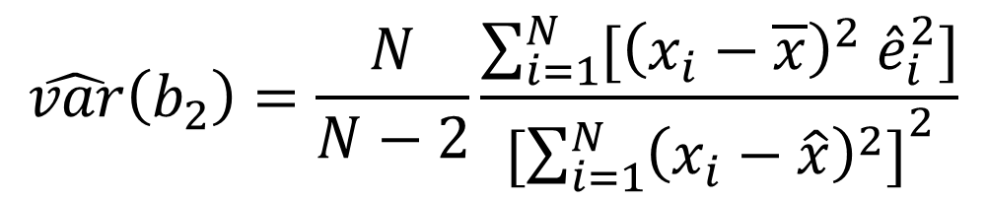
Heteroskedasticity-Consistent Standard Errors
An unbiased estimator is :
$$\hat{var}\left(b_{2}\right)=\frac{N}{N−2}\frac{\sum_{i=1}^{N}{[{\left(x_{i}−\overline{x}\right)}^{2} {\hat{e}}_{i}^{2}]}}{[{\sum_{i=1}^{N}{{\left(x_{i}−\hat{x}\right)}^{2}]}}^{2}}$$

Slide 29
Heteroskedasticity-Consistent Standard Errors
These standard errors are known as:
White’s heteroskedasticity-consistent standard errors, or
Heteroskedasticity robust standard errors, or
Robust standard errors.

Slide 30
Heteroskedasticity-Consistent Standard Errors
With White’s robust standard errors, standard errors are correct. However the estimator is still not best.
With a large enough sample size, this is not a problem - variance of the least squares estimator may still be sufficiently small to get precise estimates
Using least squares with robust standard errors has one big advantage - it avoids the need to specify a suitable variance function
To find an alternative estimator with a lower variance it is necessary to specify a suitable variance function.

Slide 31
Weighted Least Squares

Slide 32
Weighted Least Squares : Known Form of Variance
We can develop an estimator that is more efficient than the least squares estimator if we know the form of the variance σ²_{i} .
For example:
we can give each observation a different weight higher weight to observations with smaller variance. This is the weighted least squares/ generalized least squares estimator.

Slide 33
Weighted Least Squares : Known Form of Variance
Least squares estimated food expenditure function and observed data points
As the size of the economic unit becomes larger, there is more uncertainty associated with the outcomes y. These observations are less informative, and should get a lower weight.

Slide 34
Weighted Least Squares : Known Form of Variance
Minimizing the sum of squared transformed errors:
The errors are weighted by

Slide 35
Weighted Least Squares : Known Form of Variance
Weighted Least Squares estimator is more efficient than the least squares estimator if we know the form of the variance
However if our assumption regarding the form of the variance is incorrect, then not only will the estimator be inefficient - the SE will also be incorrect!

